Slide 1
Improving classification performance on Titanic dataset

Slide 2
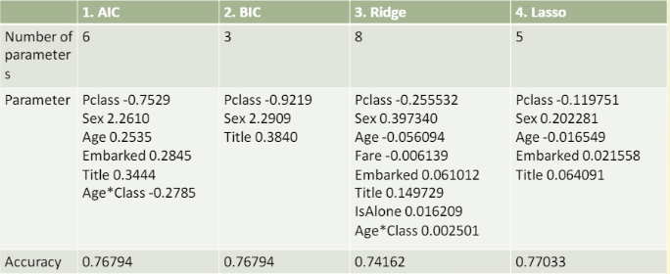
Result from project 1

Slide 3
3 Objectives
Improving Classification Performance with discretization
Improving Classification Performance with different model
Improving Classification Performance with hyper-parameters tuning

Slide 4
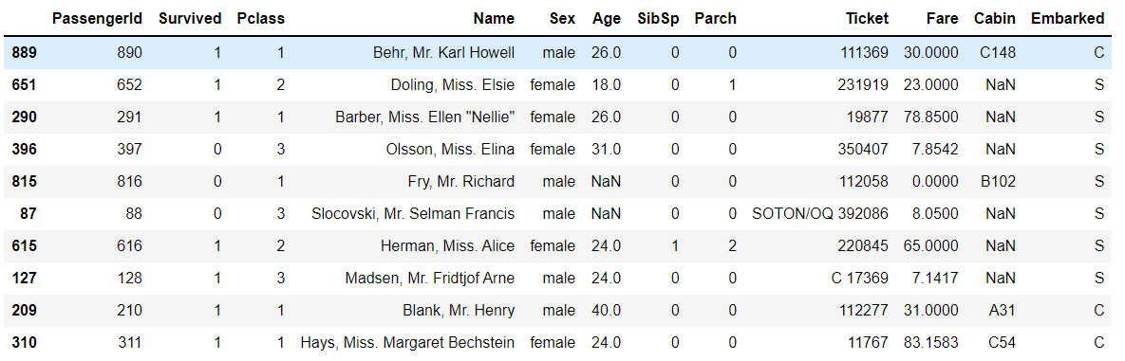
Brief desciption on data pre-processing
Fill in age, embark, fare missing value
Drop passenger id, cabin and ticket
Create family size feature
Extract title from name

Slide 5
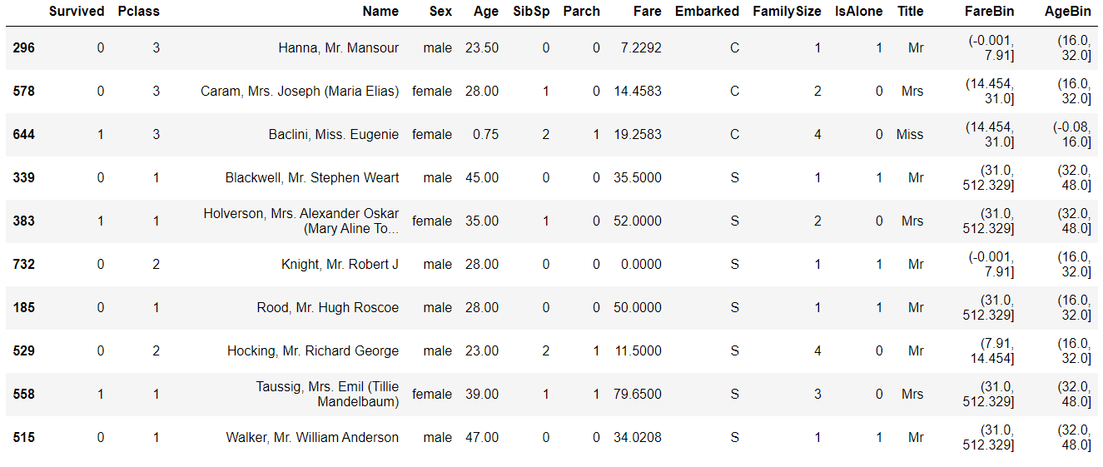
Feature discretization/Binning
Among all variables, only age and fare are continous variables
Notes:
a process of converting continuous data attribute values into a finite set of intervals

Slide 6
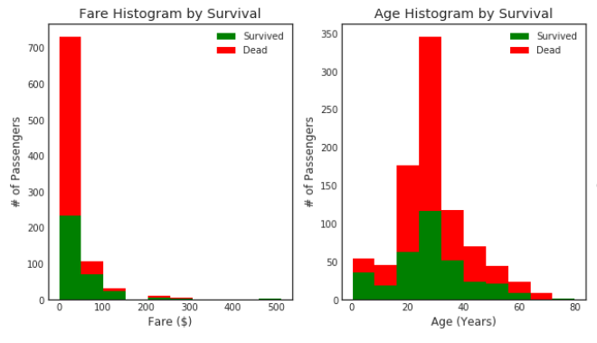

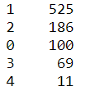
Apply feature discretization/binning
Pandas method Qcut is applied to Fare
Pandas method cut is applied to Age

Slide 7
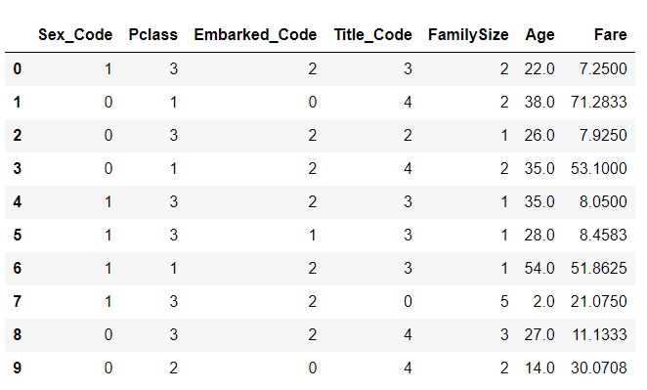
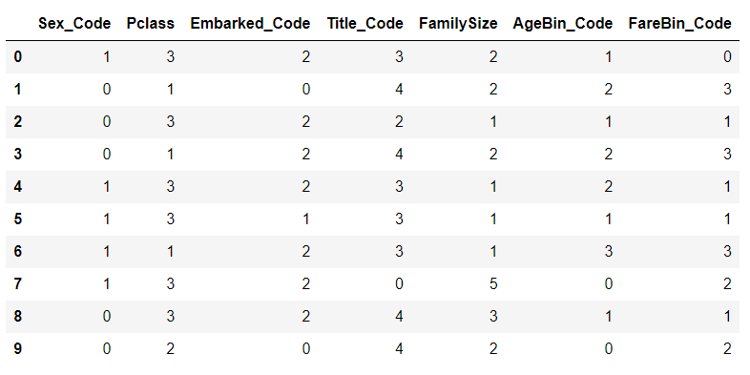
Without discretization vs with discretization

Slide 8
How feature discretization/Binning affect performance?
Intution:
Some information may loss because of feature discretization
Hypothesis:
Performance should increase for linear model
Performance will be at least the same for non-linear model
Should have little to no effect on tree-based model
Less overfitting with feature discretization

Slide 9
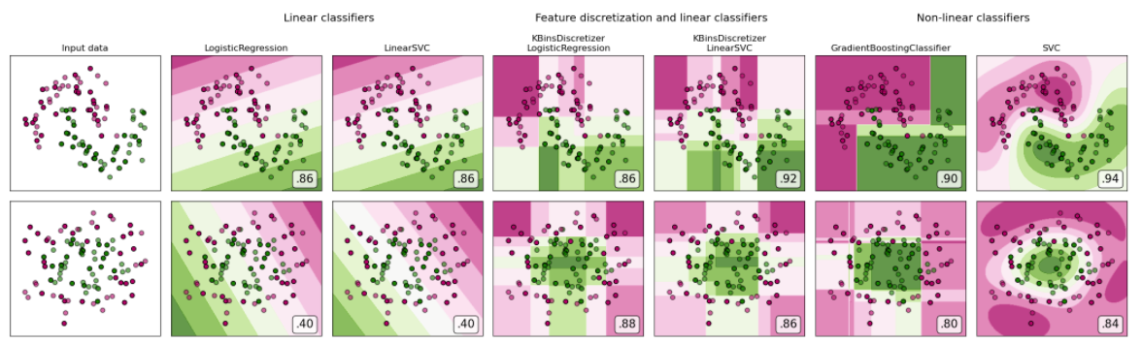
Rationale behind the hypothesis
With 2 features, binning can create similar effect for linear model as non-linear classifier

Slide 10
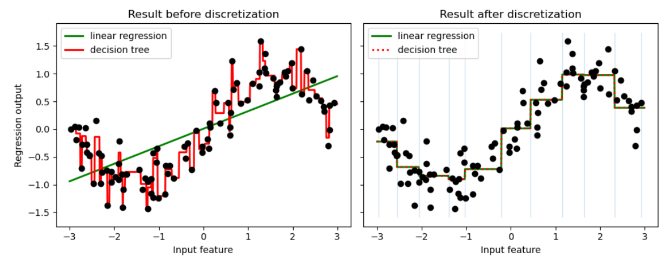
Rationale of the hypothesis
However, for non-linear model( e.g. decision tree), binning does not help
Less overfit, because reduce noise/variance (at the cost of increasing bias)

Slide 11
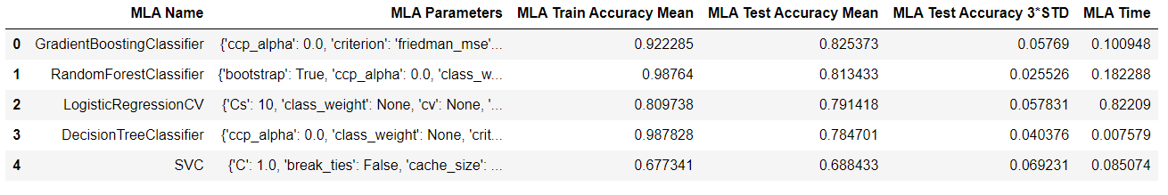
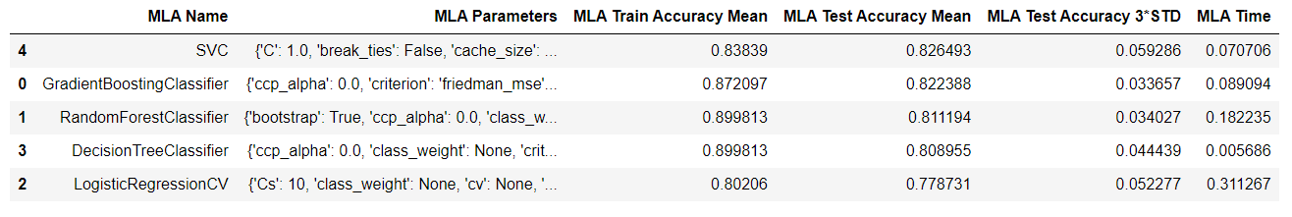
Result
Without discretization
With discretization

Slide 12
Analysis
Performance does not increase for logistic regression(Without discretization testing accuracy:0.791418, With discretization:0.778731)
All other models’ test accuracy increase
For tree-based models, the test accuracy mostly remain the same or slightly increase
Without discretization, some models’ train accuracy goes up to >0.9

Slide 13
Explaination
Is the dataset linearly seperable?
Is the two features with binning apply important?
Is the model optimize?

Slide 14
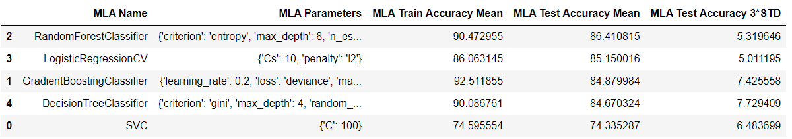
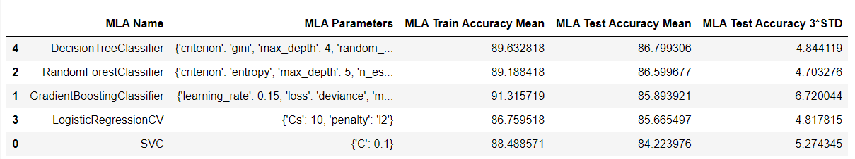
Improving Classification Performance with hyper-parameters tuning
Without discretization
With discretization

Slide 15
Analysis
All model improves after grid search
Comparing with or without discretization:
Performance increases slightly for logistic regression(Without discretization testing accuracy:0.8515, With discretization:0.8566)
All other models’ test accuracy increase with discretization
The second most significant increase is from decision tree model(Without discretization testing accuracy:0.84670, With discretization:0.86799)
The most significant increase is from SVC(Without discretization testing accuracy:0.74335, With discretization:0.84224)

Slide 16
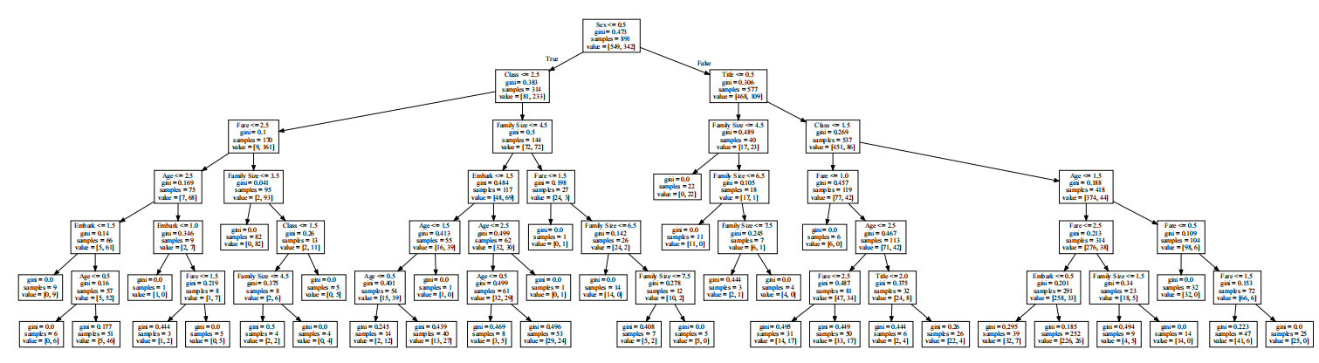
Best model overall
Decision Tree with discretization

Slide 17
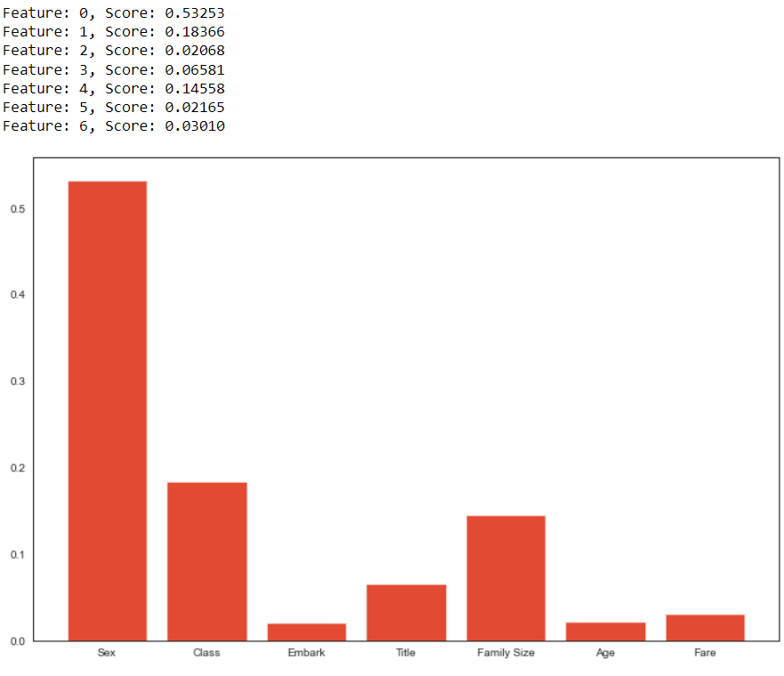
Feature importance

Slide 18
Conclusion
Compare to the logistic regression model in project 1, the performance has been improved by completing the 3 objectives.
Using feature discretization, most models’ test accuracy improve
Using different kind of models, tree-based model (e.g. decision tree) works much better for this dataset
Using hyper-parameters tuning, all models’ test accuracy improve significantly

Slide 19
Reference
Decision Tree visualization
https://mljar.com/blog/visualize-decision-tree/
https://machinelearningmastery.com/calculate-feature-importance-with-python/
Feature discretization
https://www.kaggle.com/tilii7/feature-discretization-less-is-better
https://scikit-learn.org/stable/auto_examples/preprocessing/plot_discretization_classification.html
https://pbpython.com/pandas-qcut-cut.html
https://scikit-learn.org/stable/auto_examples/preprocessing/plot_discretization.html

